Slide 1
Builder
Compositional Design – with a twist…

Slide 2
Problem
Consider your favorite
  Text editor, word processor, spreadsheet, drawing tool
They allow editing a complex data structure representing a document, spreadsheet, etc.

Slide 3
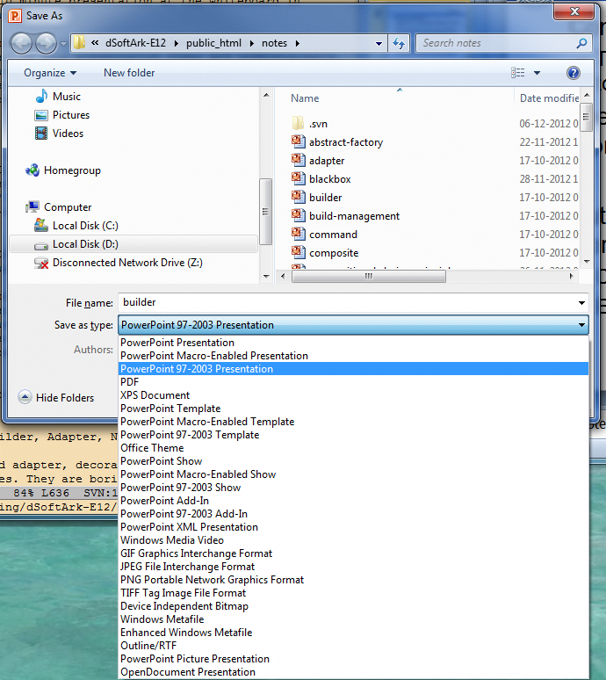
Problem
But they also need to save it to a persistent store, typically a hard disk.
  Converting internal data structure to external format
  Ex: Binary encoding, XML, HTML, RTF, PDF, …

Slide 4
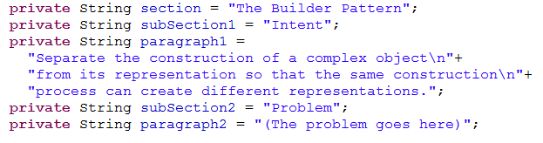
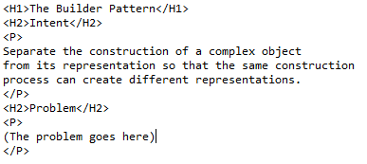
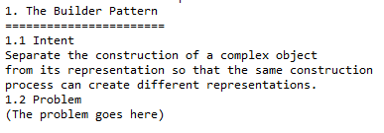
Example
A document consists of
  Sections, subsections
  paragraphs
We like to output in formats:
HTML
Or ASCII

Slide 5
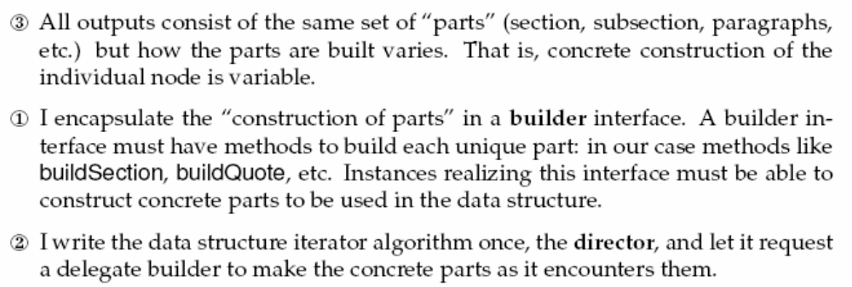
3-1-2
A classic variability problem

Slide 6
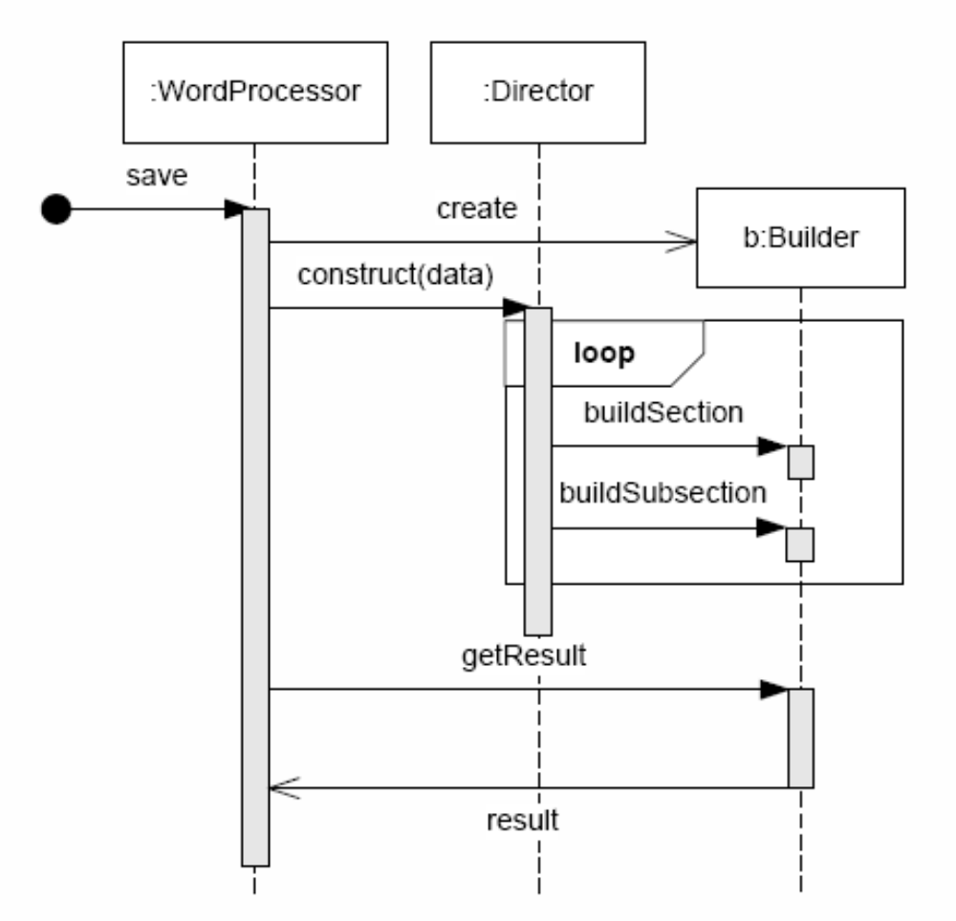
Dynamics
Create the builder
  User chose ‘html’ or ‘ascii’
The common part is the director that knows the structure and iterates over all its parts.
The builder handles building each part for the particular output format
Output data structure is known to the client

Slide 7
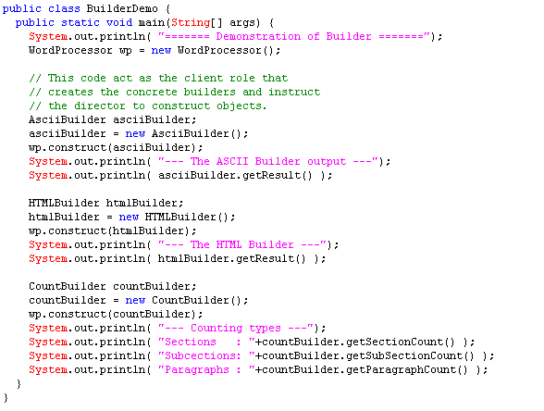
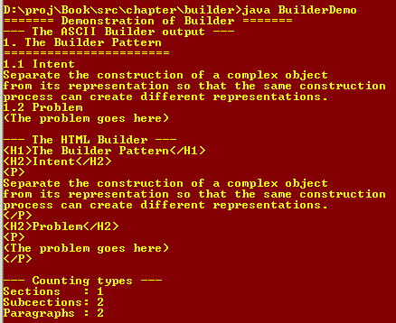
Demo Code

Slide 8
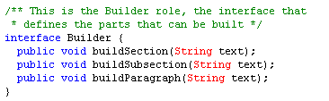
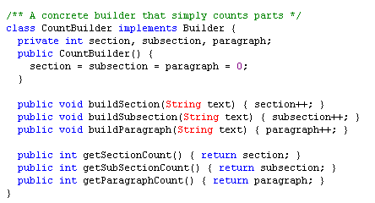
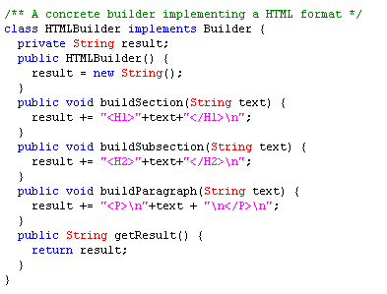
Builder part

Slide 9
Exercise
Why is there no getResult method defined in the interface???

Slide 10
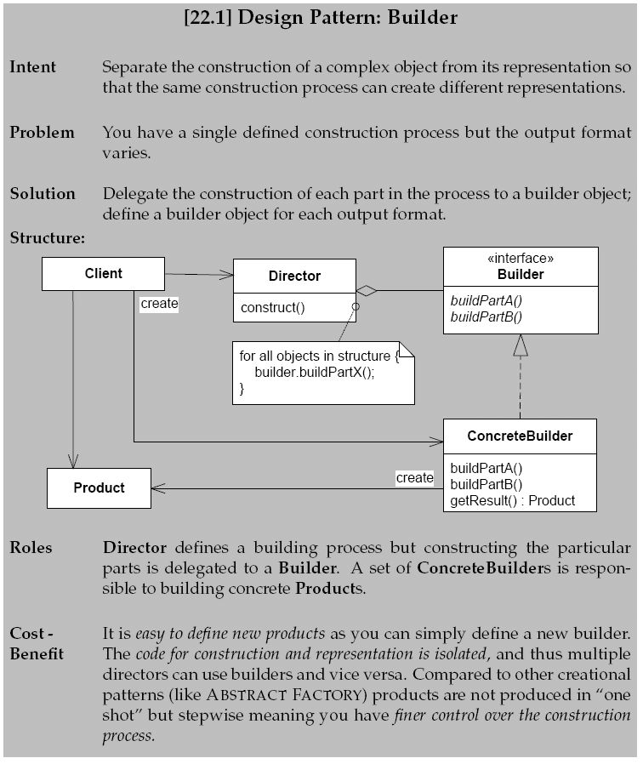
The Pattern

Slide 11
Aspects
Benefits are
  Fine grained control over the building process
    Compare to Abstract Factory
  Construction process and part construction decoupled
    Change by addition to support new formats
    Many-to-many relation between directors and builders
      Reuse the builders in other directors…
Liabilities
  Client must know the product of the builder as well as the concrete builder types

